Slide 1


UK Food Incident Notifications (2023–2024)
Module Code - COM7203
Module title: Data Science and Visualization
Name: Zarin Tasnim Nuzhat
Student Number - 2510148

Slide 2

Dataset Overview
Source: data.gov.uk — Food Incident Notifications (2023 and 2024).
Two datasets were merged into a single analytical file.
Final dataset: 3,588 incident records.
Standardized fields include:
Incident ID
Received (date only)
Incident Type
Product Type
Notifier Type
Origin Country
Incident Source

Slide 3

Data Preparation Using Python
I performed data preparation using Python (pandas) in Visual Studio Code:
Loaded both Excel datasets (2023 & 2024).
Standardized column names.
Cleaned and converted mixed date formats.
Removed time component (kept date only).
Removed nulls and placeholder strings.
Deduplicated using Incident ID.
Sorted dataset chronologically.
Exported final clean file: merged_incidents_final_clean.csv.

Slide 4
Tools and Platforms Used
Python (pandas) — Data cleaning and transformation
Visual Studio Code — Integrated development environment
Power BI Desktop — Interactive visualisation and insight generation
Microsoft PowerPoint — Final presentation creation
Data.gov.uk — Official UK government datasets

Slide 5
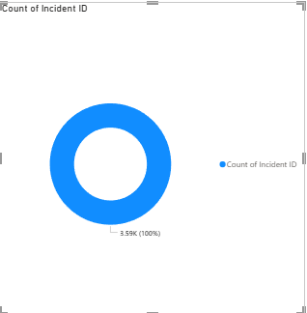
Overall Trends in Food Incident Notifications
Total incidents across 2023–2024
Year-to-year comparison
Monthly trend patterns
Most common product categories

Slide 6
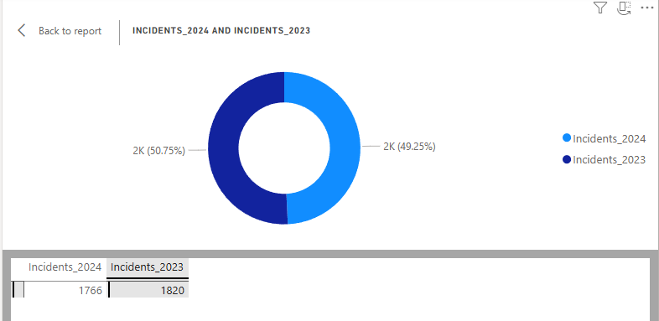

Slide 7
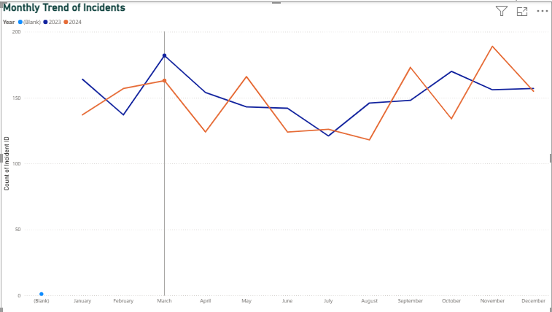
Monthly Incident Trends
Incidents fluctuate seasonally across both years.
Peaks could be caused by supply chain pressure, production cycles, or seasonal imports.
Certain months' incident volumes indicate times of higher risk.

Slide 8
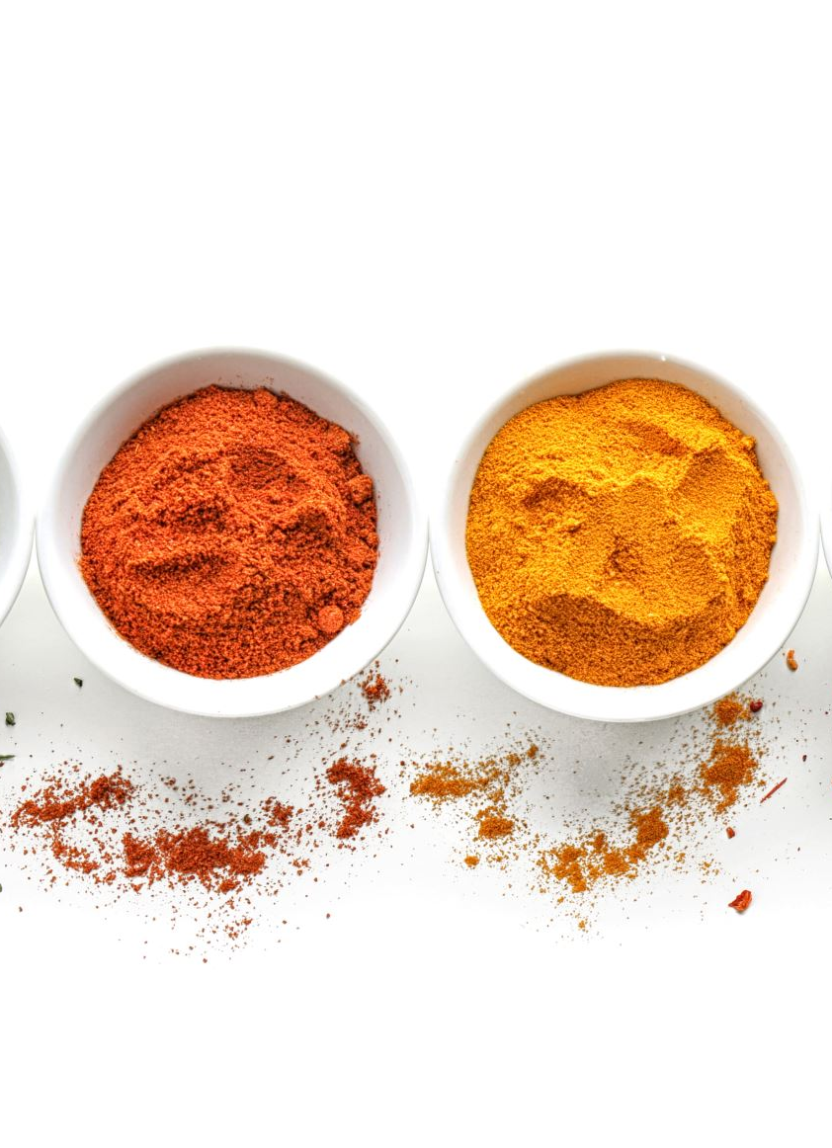
Product Category Distribution of Food Incidents
The distribution of incidents varies depending on the type of product.
Meat & Meat Products have the highest incident counts, indicating a consistently high-risk area.
The next main contributors are Fruits & Vegetables, Poultry Meat, and Prepared Dishes & Snacks.
Several categories exhibit moderate but noteworthy incident volumes, such as Herbs & Spices, Cereals & Bakery, Dietetics, and Milk Products.
Although they make up smaller percentages, smaller categories nevertheless suggest possible niche risks.

Slide 9
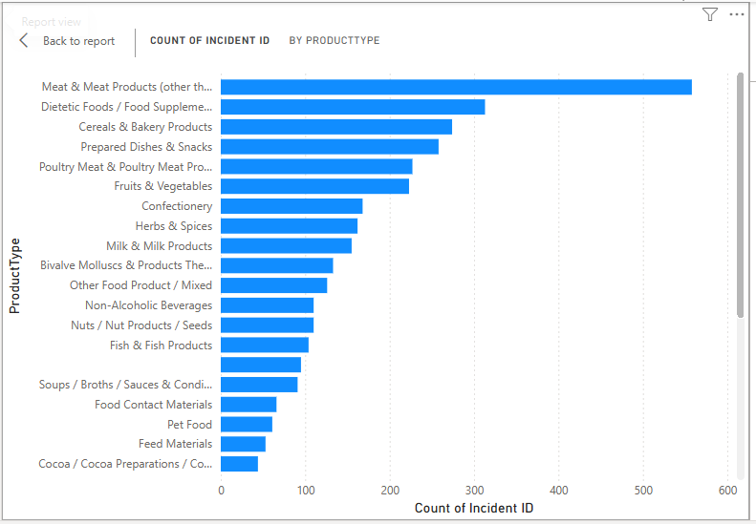

Slide 10
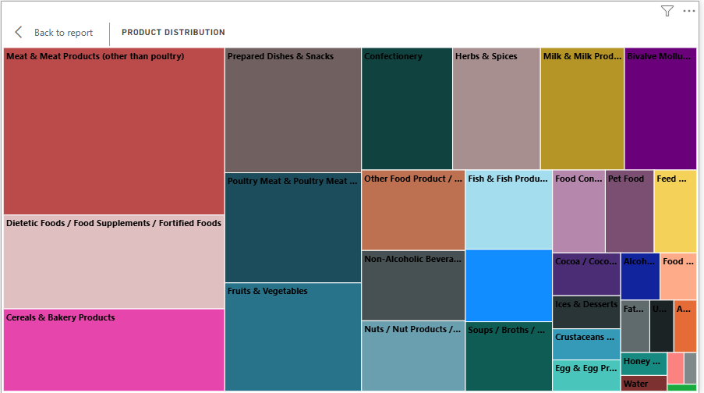

Slide 11
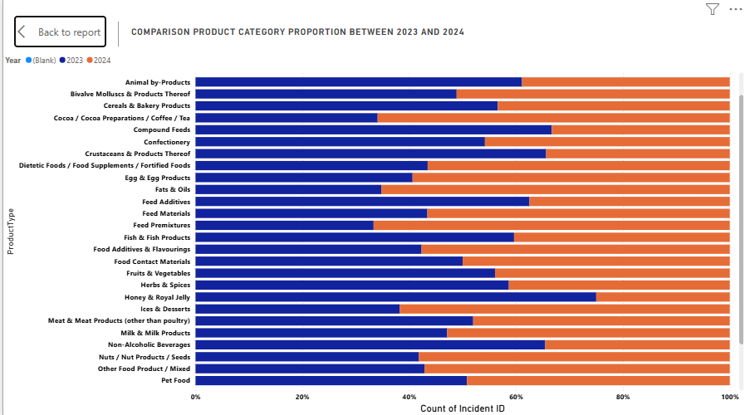

Slide 12
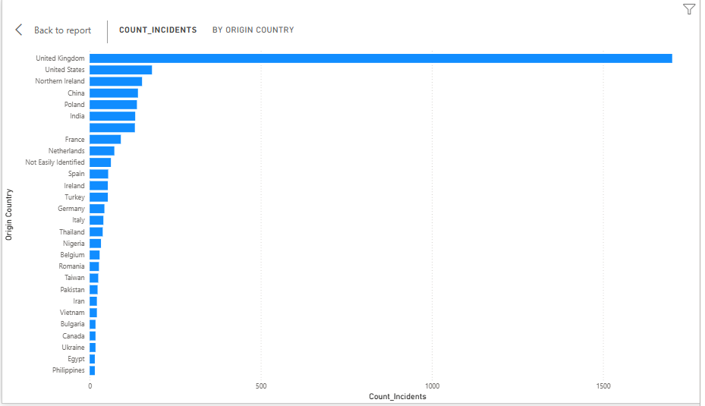
Geographical Distribution of Incidents
Several incidents originate from UK supply chains.
Imported incidents are linked to countries including France, Romania, Tanzania, and Paraguay.
Maps reveal spatial clusters.

Slide 13
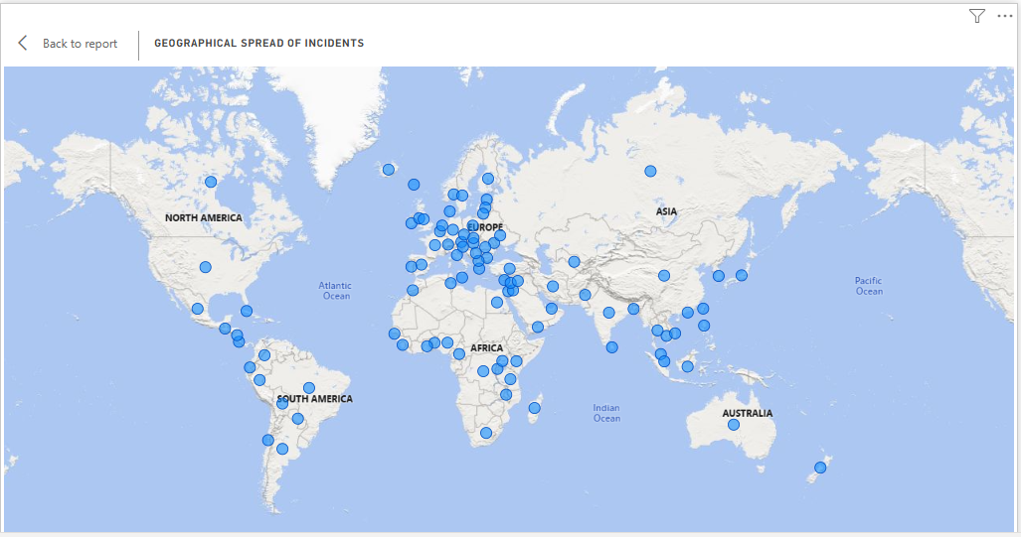

Slide 14

Hazard Types and Reporting Sources
Typical incident categories are as follows:
Allergen problems
Microbial contamination
Chemical contamination
Incorrect labelling/packaging
Sources of reporting are primarily:
The industry
RASFF (Rapid Alert System for Food and Feed)
Local governments

Slide 15
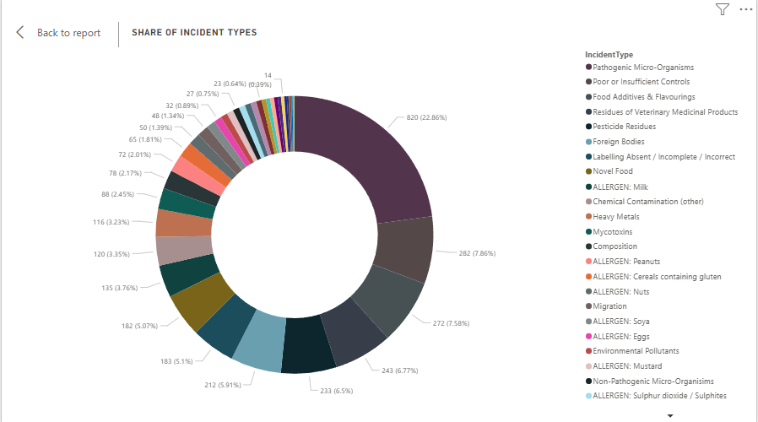

Slide 16
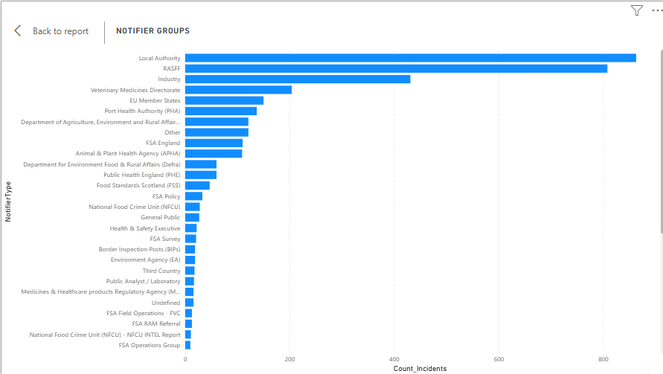

Slide 17
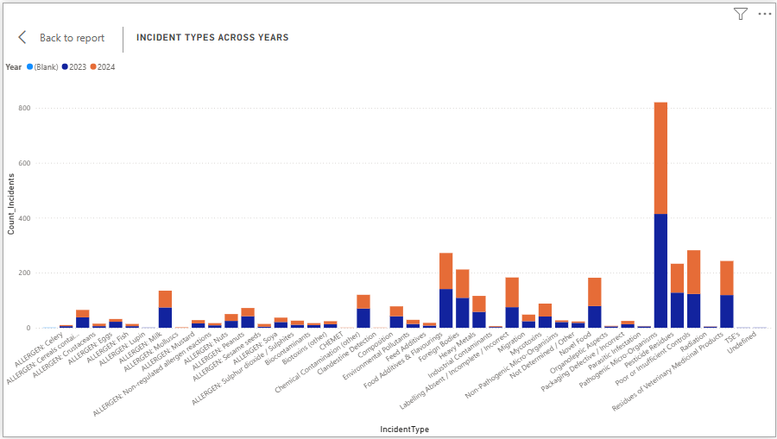

Slide 18

Key Findings
Incident volumes reveal not only seasonal but also product-specific risks.
A small quantity of items represents a big part of the total incidents.
Countries of origin highlight the risk areas in the supply chain.
Allergen and microbiological incidents hold the largest share in the dataset.
The 2023-2024 changes suggest alterations in reporting practices and supply trends.

Slide 19

Recommendations
Inspect high-risk product categories that are specified by targeting.
Heighten the enforcement of allergen labelling for bakery and prepared foods.
Conduct focused audits in origin countries that have been repeatedly flagged.
Extend the monitoring period to the months with the highest occurrence of incidents.
Set better reporting standards to do away with the inconsistent categorisations.

Slide 20
Limitations
Some dates are not clear or are missing (NaT).
There is no complete standardisation of categories over the years.
There is a potential reporting bias because of the predominance of the industry in the submissions.
There is no information about the severity or the outcome in the dataset.
There are no details about the demographic or consumer impact.

Slide 21

References
UK Government Data Service. (2023–2024). Received Food Incident Notifications. Retrieved from data.gov.uk
Food Standards Agency (FSA) (2024) Food and Feed Incident Notifications. Available at: https://www.data.gov.uk.
European Commission (2023) Rapid Alert System for Food and Feed (RASFF) Portal – Annual Report. Publications Office of the European Union.
UK Government (2024) Food Safety Act 1990: Guidance. Available at: https://www.gov.uk.
Food Standards Agency (2023) Food Safety and Hygiene: Regulatory Framework. FSA Publications.
McKinney, W. (2018) Python for Data Analysis: Data Wrangling with pandas, NumPy, and IPython. 2nd edn. O’Reilly Media.
Microsoft Corporation (2024) Power BI Desktop Documentation. Available at: https://learn.microsoft.com/power-bi.
Food Standards Agency (2024) Annual Report and Accounts. Available at: https://www.food.gov.uk.
UK Office for National Statistics (2023) Statistical Quality Guidelines. ONS Methodology Series.

Slide 22

Thank you.
Any questions?

